Slide 1
IST-718: Final Project
Human Protein Atlas Single Cell Classifier
Team: SriHari Busam, Sharat Sripada
Code repository: https://github.com/srihari-busam/hpa-deep-learning

Slide 2
Introduction
Historically, classification of proteins has been limited to single patterns in one or a few cell types, but in order to fully understand the complexity of the human cell, models must classify mixed patterns across a range of different human cells.
Advances in high-resolution microscopy has made it possible to generate images of cells comprising proteins at greater pace and volume than those generated manually. As such, the need is greater than ever to automate biomedical image analysis and classification
Kaggle competition:
https://www.kaggle.com/c/hpa-single-cell-image-classification/overview
Problem Statement
To develop models capable of classifying mixed patterns of proteins in microscopic images
Goals
To hit prediction accuracy on the validation set >44% (Kaggle Leaderboard at the time we started work on this project)
Experiment and build different convnets and weigh them based on Key Performance Indices (KPIs) like Accuracy and Time to compile/build the model
Classes of proteins
0. Nucleoplasm
1. Nuclear membrane
2. Nucleoli
3. Nucleoli fibrillar center
4. Nuclear speckles
5. Nuclear bodies
6. Endoplasmic reticulum
7. Golgi apparatus
8. Intermediate filaments
9. Actin filaments
10. Microtubules
11. Mitotic spindle
12. Centrosome
13. Plasma membrane
14. Mitochondria
15. Aggresome
16. Cytosol
17. Vesicles and punctate cytosolic patterns
18. Negative

Slide 3
High-level project Pipeline
Stage-1 (Initial EDA)
Stage-2 (Modeling)
Stage-3
(Results)
EDA on train.csv to study frequencies and protein/cell associations
Keras ImageDataGenerator() to split data into train, validation and test
Measure label prediction accuracy and performance (run-time)
Study the data (scale):
-21k 2048x2048 images
-Image samples are split GBRY mapping to protein, nucleus, microtubules and endoplasmic reticulum respectively
Experiment with different CNN models (layers and optimization functions)
Visualizations - accuracy per class across models via confusion matrix and loss vs accuracy plots
HPA cellsegmentator python libraries to predict and label cells based on nuclei/cell patterns - resulted in ~150k images
VGG16
ResNet101
EffNet

Slide 4
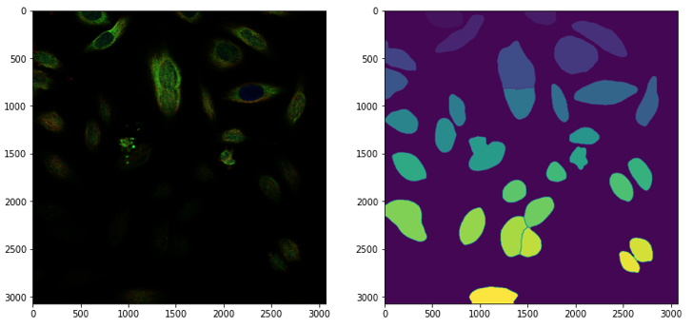
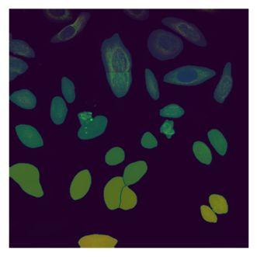
HPA cell segmentation library
The cellsegmentator library has the following utilities:
pred_nucluei:
takes a list of image arrays (nuclei in third channel - blue) and returns list of neural network outputs of nuclei segmentation
pred_cells:
takes a list of images ( microtubules, endoplasmic reticulum, and nuclei in that order) and returns list of outputs of cell segmentation
label_nucluei:
takes nuclei prediction for an image and returns the labeled nuclei mask array
label_cells:
takes nuclei and cell prediction for an image and returns the labeled nuclei and cell mask arrays as a tuple
Original Image
Mask generated by cell segmentation pred_cells()
Resulting Image - Mask superimposed over Original Image

Slide 5
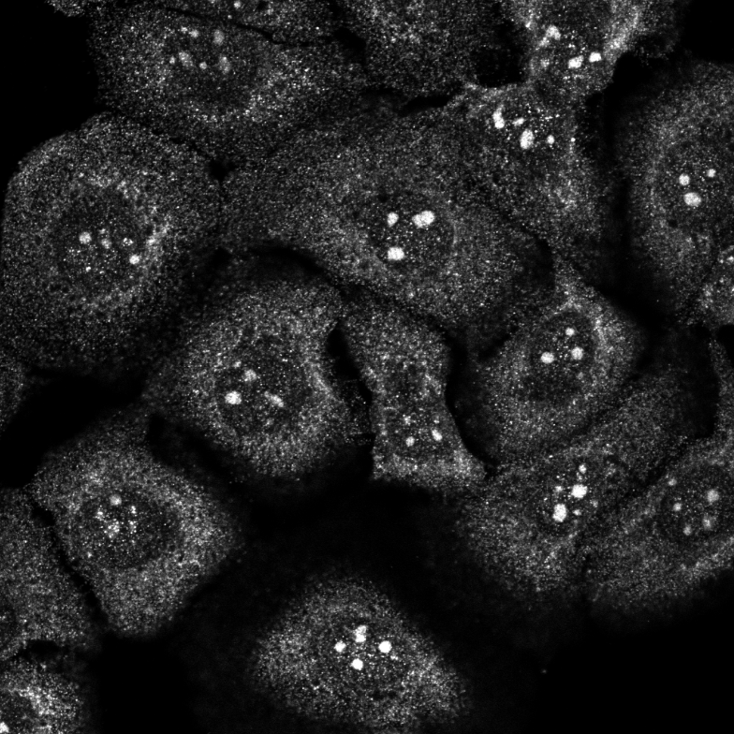
About the data
Training dataset - 21,806 samples (x4 - Red, Green, Blue, Yellow)
Each image is 2048 X 2048 resolution
Data posed following challenges
Weak labels
Images has more than one cell and the label only tells what types of proteins/cells are present
Image has 3 types of cells: Nucleoli, Mitochondria, Cytosol
ImageId: 0fe26432-bb9a-11e8-b2b9-ac1f6b6435d0

Slide 6
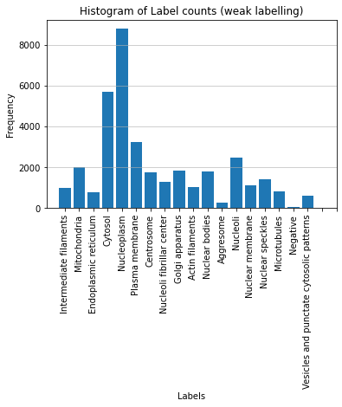
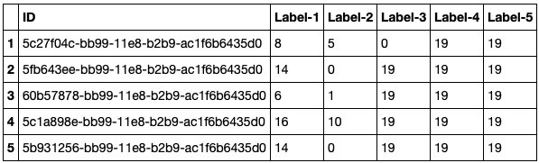
Exploratory Data Analysis (on weak labels/train.csv)
Initial EDA was on train.csv comprising weak labels linked to each image
Sample of transformed data shown below where an image may have upto 5 labels
NOTE: 19 is a custom label showing no data
Histogram showing the distribution of various proteins/other cell components across 21807 images
Classes of proteins
0: 'Nucleoplasm',
1: 'Nuclear membrane',
2: 'Nucleoli',
3: 'Nucleoli fibrillar center',
4: 'Nuclear speckles',
5: 'Nuclear bodies',
6: 'Endoplasmic reticulum',
7: 'Golgi apparatus',
8: 'Intermediate filaments',
9: 'Actin filaments',
10: 'Microtubules',
11: 'Mitotic spindle',
12: 'Centrosome',
13: 'Plasma membrane',
14: 'Mitochondria',
15: 'Aggresome',
16: 'Cytosol',
17: 'Vesicles and punctate cytosolic patterns',
18: 'Negative'

Slide 7
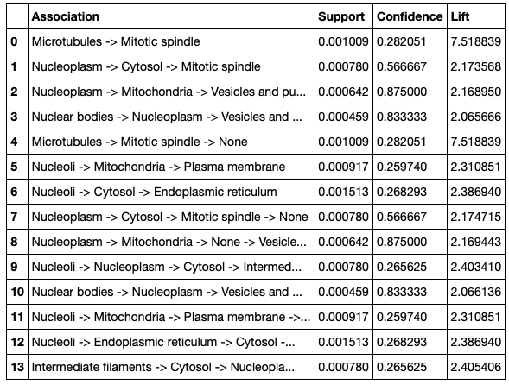
Exploratory Data Analysis (on weak labels/train.csv)
Finally, we were interested in understanding proteins or other cell components that occurred frequently using the Apriori algorithm/Associated Rule Mining technique
The table alongside shows relationships - highlighted ones relatively with high confidence while others in 25-30%

Slide 8
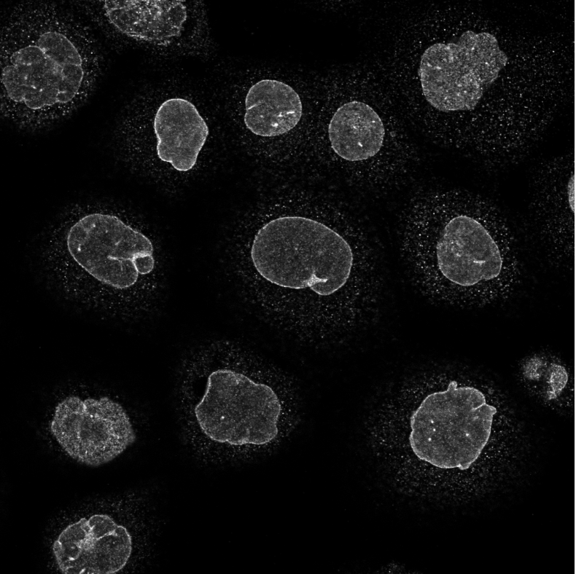
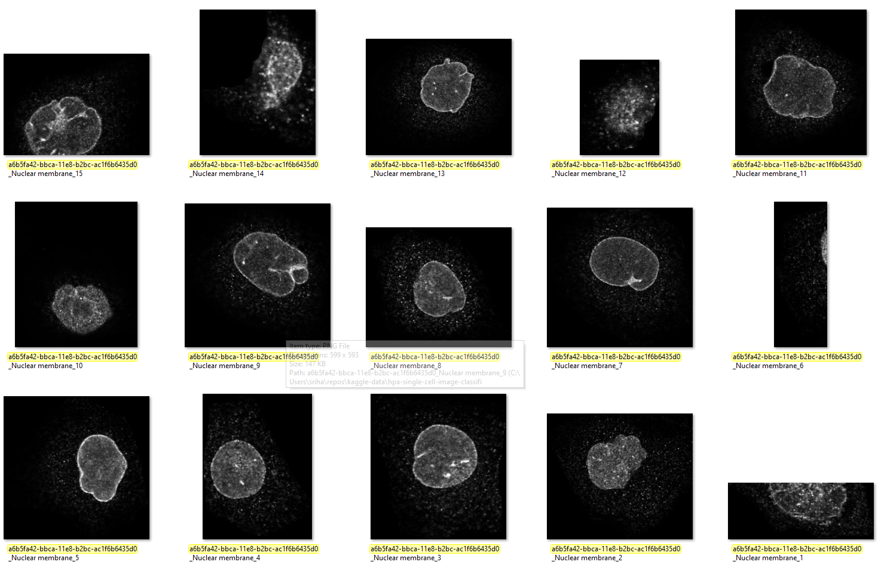
Solving the data challenge
The idea was to convert weak labels to concrete labeled data
Approach
Identified images that only has one class. There are about 10,412 images with single cell type only
Used the previous competition cell segmentation model to separate them into individual cell images(python magic used to isolate the images)
This approach resulted in 151,707 strong labeled samples
It took ~2 days to convert the data!!
Imageid shown: a6b5fa42-bbca-11e8-b2bc-ac1f6b6435d0_Nuclear membrane

Slide 9
Data cleanup & scoping for modeling
After conversion removed all files <4kb and >1MB
Reasoning:
Small size - may not have enough features
Large size – compression may introduce artifacts
Scoped to 12 classes only
When the experiments started Kaggle has about ~40% as the top. We want to hit atleast 50% accuracy and one way we thought is to have enough samples to train.
Chosen classes with more than 1k samples
“Negative” class images are removed as these could be any cell image and could be a noise

Slide 10
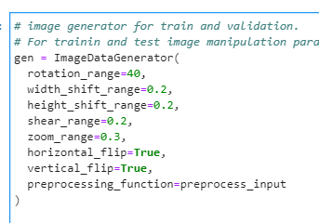
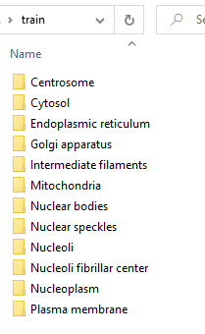
Setting up the data
Initial experiment was done using manual image manipulation
Later we leveraged keras image generator to do all the image manipulation heavy lifting
Leveraged “flow_from_directory” to feed training and validation data with image resize to 528 X 528 (Actual EfficientNetB6 is built on the specific resolution)
Setup for “flow_from_directory”
Image manipulation

Slide 11
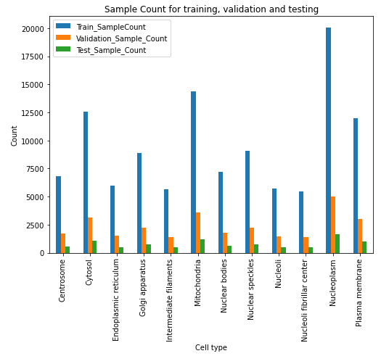
Stratified samples details
Total concrete labeled used for the analysis: 151,707 images
Samples are divided into training, validation and testing as follows
Total training samples: 113,780
Total validation samples: 28,445
Total test samples: 9,482

Slide 12
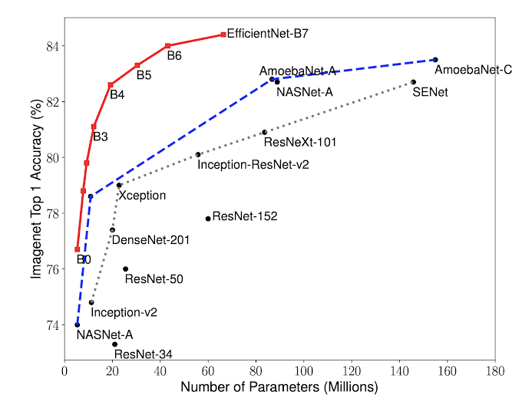
Introduction to CONVNET
Considered the following models:
VGG16
ResNet101
EfficientNetB6
Python libraries
PyTorch for segmentation of images to individual cells
Keras with Tensorflow 2.4 backend for all the model building
Hardware/GPU
CPU: AMD 5800X 8C 16Threads with 128 GB RAM
GPU: NVIDIA RTX 3090 with 24GB RAM
EfficientNet performance compared to other models on Imagenet dataset

Slide 13
Convnet models - experiments & results
Model based on | Input Details | Trainable params | Optimizer | Training Time | Training Accuracy | Validation Accuracy
VGG16 16 layers Weights: None Weights locked : NO | Res:512 X 512 Batchsize: 32 Steps per epoch:100 Validation steps: 20 | 14,714,688 | Adam (lr=0.0001) | ~5hrs | 46.59% | 48.59%
Resnet101 101 layers Weights: imagenet Weights locked : NO | Res:512 X 512 Batchsize: 24 Steps per epoch:120 Validation steps: 30 | 48,844,300 | NAdam (lr=0.0001) | ~5hrs | 49.78% | 51.94%
EfficientNetB6 Weights: imagenet Weights locked : NO | Res:512 X 512 Batchsize: 7 Steps per epoch:150 Validation steps: 10 | 40,763,364 | Nadam (lr=0.0001) (tried Ada, rmsprop,SGD) | ~8hrs | 70.08% | 67.14%

Slide 14
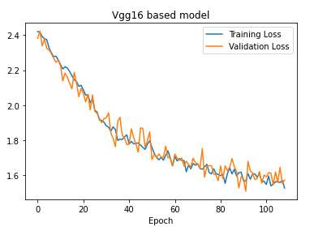
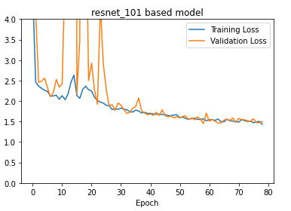
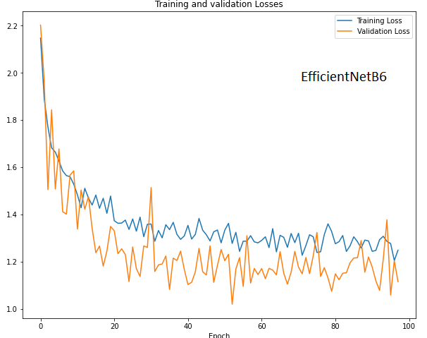
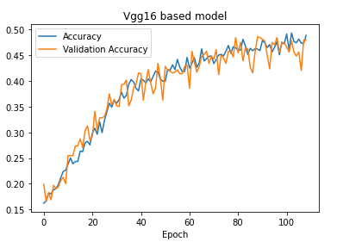
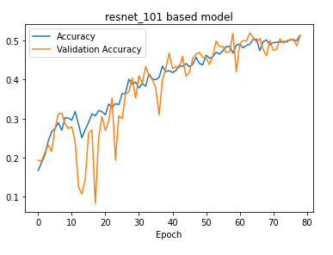
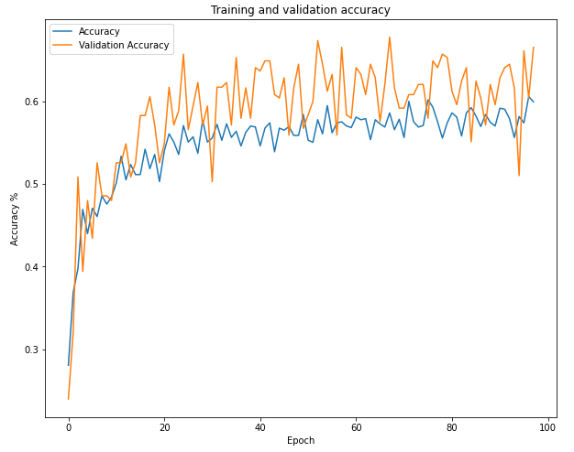
Loss & Accuracy
Accuracy
Epoch

Slide 15
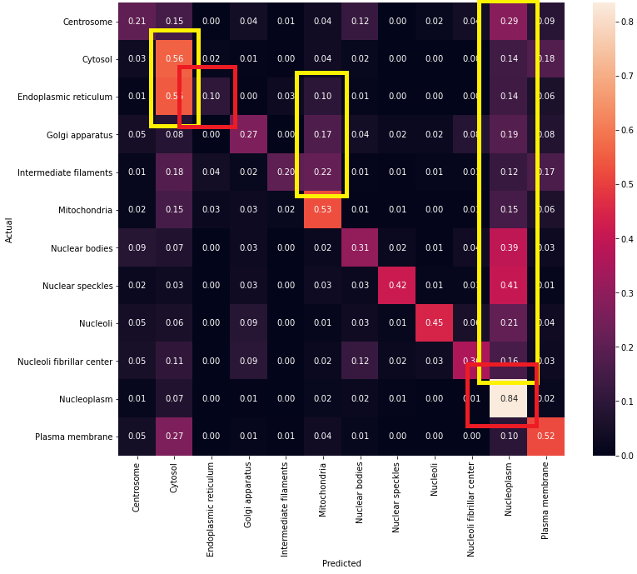
Confusion matrix(actual vs predicted %) – VGG
Validation samples: 28,445
Overall Validation Accuracy: 48.59%
Test samples : 9,482
Highest Accuracy:
Nucleoplasm (84%)
Lowest Accuracy:
Endoplasmic reticulum – 10%
Intermediate filaments – 20%
Top mis classification:
Cytosol
Mitochondria
Nucleoplasm

Slide 16
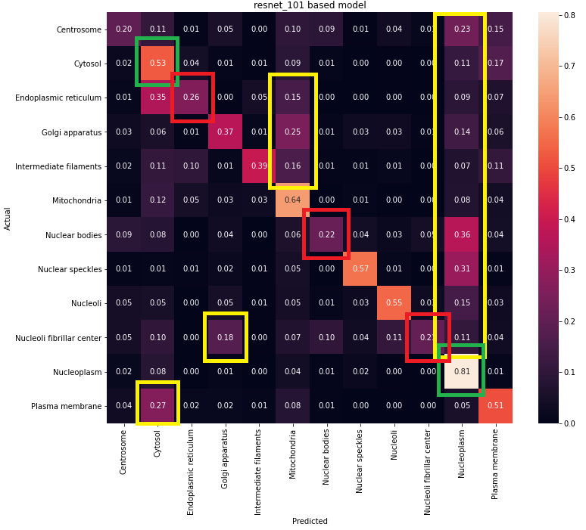
Confusion matrix(actual vs predicted %) – Resnet
Validation samples: 28,445
Overall Validation Accuracy: 51.94%
Test samples : 9,482
Highest Accuracy:
Nucleoplasm (81%)
Cytosol (54%)
Lowest Accuracy:
Endoplasmic reticulum – 26%
Nucleoli fibrillar center– 21%
Nuclear bodies – 22 %
Top mis classification:
Cytosol
Mitochondria
Nucleoplasm
Golgi apparatus

Slide 17
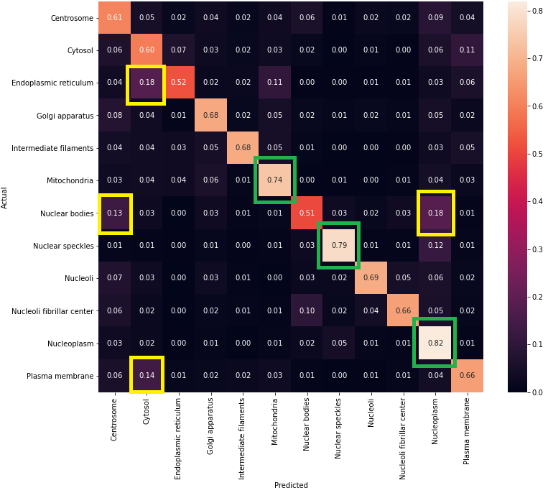
Confusion matrix(actual vs predicted %) – EfficientNetB6
Validation samples: 28,445
Overall Validation Accuracy: 67.14%
Test samples : 9,482
Highest Accuracy:
Nucleoplasm (82%)
Nuclear speckles (79%)
Mitochondria ( 74%)
Lowest Accuracy:
Endoplasmic reticulum – 52%
Top mis classification:
Nuclear bodies
Nucleoplasm
Cytosol

Slide 18
Conclusion
When we started the project, the leaderboard on the Kaggle competition was at ~44% accuracy and beating this number became our immediate goal. As a team, we scoped the problem from 19 to 12 class detection but was able to achieve ~67% accuracy for the 12 classes identified.
There is still room to improve models and experiment more. However, we conclude at this point that we met our accuracy goal for the project.

Slide 19
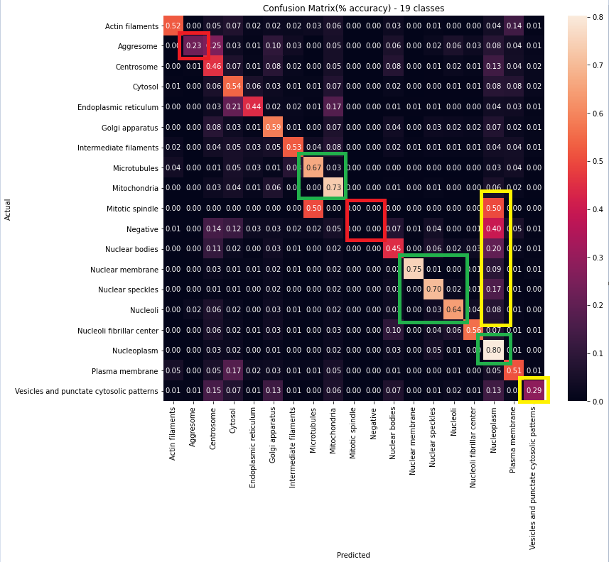
Latest model results classifying all the protein types ( With Samples skew)
Total validation samples – 48,632
Overall accuracy ~60%
Poor accuracy classes have low training samples
“Mitiotic spindle” has only 6 samples for training
“Negative” only has 700 samples
“Aggresome” – 1696
Quite a bit of proteins are classified as “Nucleoplasm”

Slide 20
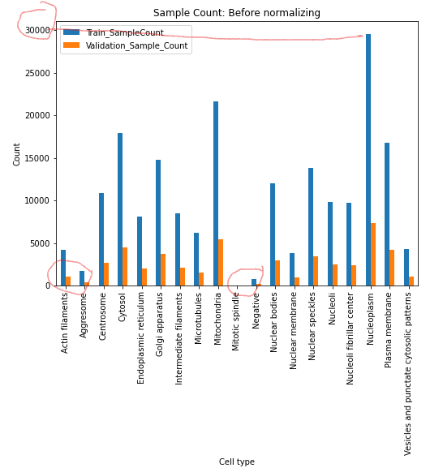
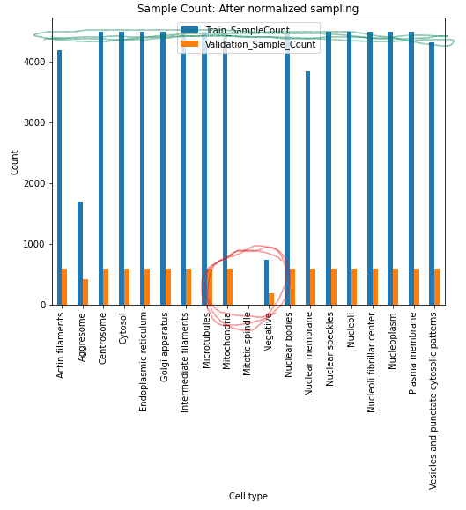
Understanding sample skew

Slide 21
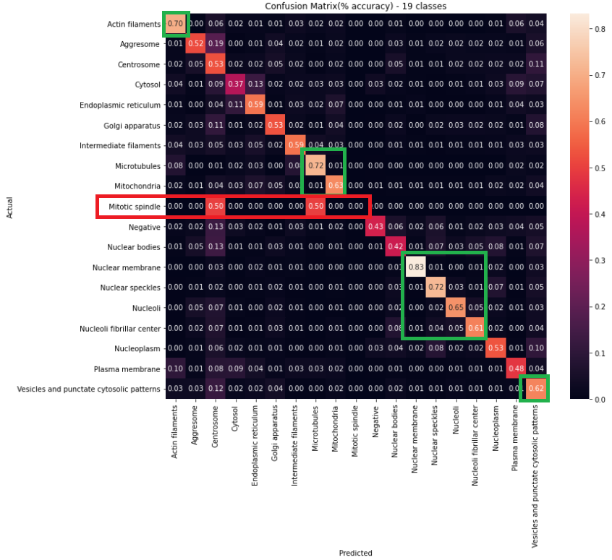
After adjusting sample skew
From previous model
Better at “Negative” class detection.
Reduced false positives on Nucleoplasm
8 classes have more than 60+ accuracy over(2+ over previous model)
Not the best like other model for Nucleoplasm( probably other models can be used to detect that protein)
There is more room for improvement

Slide 22
Next steps
Running the modeling for all the 19 classes and compare the accuracy
Reduce imbalance in training data to provide samples for all classes equally and experiment
Run the 19-class model for Kaggle test data and submit results
Tooling support to help with data cleanup(identify noise images)
Invest more on the optimizer internals and research on high performing models and tweak them and experiment. Experiment with other models like Mobilenet
Get help from an SME in the protein cell area to get advice on how to improve the models
Analyze the models in the context of scenarios like:
Whether model may not be good overall but could help finding a specific protein very well
Finding which cells have less success and remove them from the list and build a separate model

Slide 23
Q&A

Slide 24
Backup slides

Slide 25
References
Kaggle : https://www.kaggle.com/c/hpa-single-cell-image-classification/leaderboard

